Slide 1

Customer retention case study presentation
Likhitha

Slide 2
Problem statement
E-retail factors for customer activation and retention: A case study from Indian e-commerce customers
Customer satisfaction has emerged as one of the most important factors that guarantee the success of online store; it has been posited as a key stimulant of purchase, repurchase intentions and customer loyalty. A comprehensive review of the literature, theories and models have been carried out to propose the models for customer activation and customer retention. Five major factors that contributed to the success of an e-commerce store have been identified as: service quality, system quality, information quality, trust and net benefit. The research furthermore investigated the factors that influence the online customers repeat purchase intention. The combination of both utilitarian value and hedonistic values are needed to affect the repeat purchase intention (loyalty) positively. The data is collected from the Indian online shoppers. Results indicate the e-retail success factors, which are very much critical for customer satisfaction.

Slide 3
Why retention is important??
Retention is important as the customers who hold on to your shop will recommend it to their known ones
they will give good rating in the search engines that helps your shop to become more known to others
the trust you gain from your customers makes them to buy more products from your shop
these are the main points why retention is importation

Slide 4
How to retain them(customers)?
Communication helps in retaining customers
hire people who have good communication and presentation skills
provide correct information about the product
deliver the product at the expected delivery time
Keep changing the look of your application/website(this helps in keeping the customers excited)
provide good online service
These are the best ways to retain your customers

Slide 5
Eda steps
I’ve checked if any null values present in the dataset and got the result as 0 null values
I’ve check the information about the dataset and it shows us the column name, if there are any null values, the data type
I’ve checked the size of the dataset it is 269 rows and 71 columns
(have not done more EDA in this project as it’s a analysis project)

Slide 6
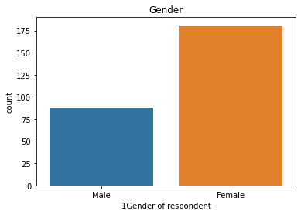
From the below plot (that is also there in ipynb file)more than 50% percent of people participated are womens

Slide 7
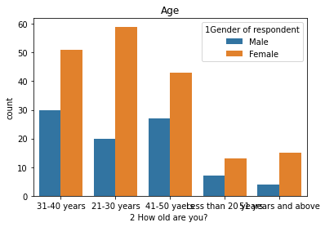
most of the participants are 21-30 years and most of them are females

Slide 8
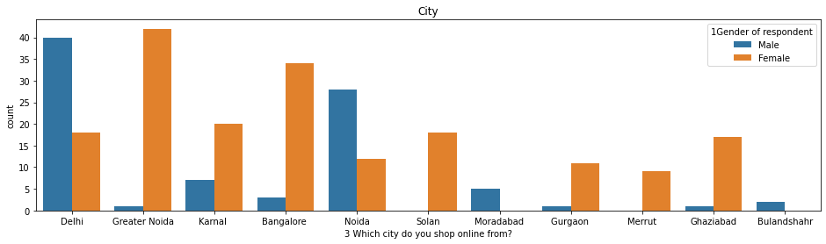
most of the participants are from Delhi and are male!!!

Slide 9
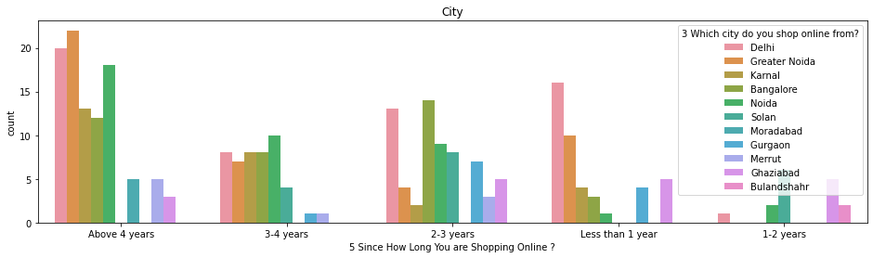
most of them have been shopping for more than 4 years and are shopping from greater Noida

Slide 10
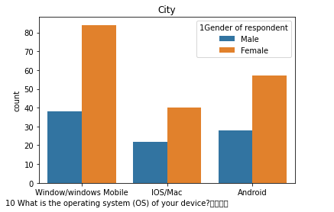
most of female participants use window/windows and mobile and most of the male participants also use window/windows and mobile

Slide 11
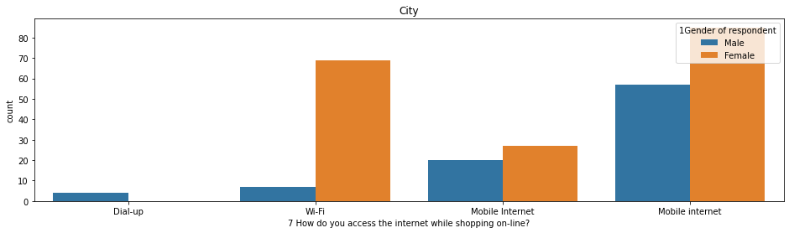
most of the participants use mobile internet

Slide 12
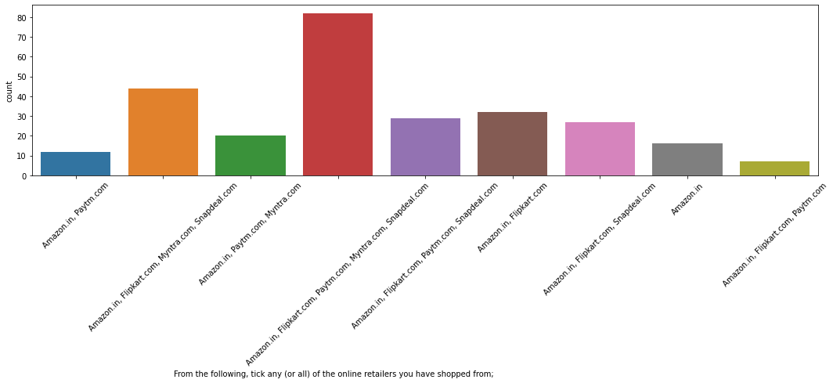
most of the participants have shopped from Amazon.in, Flipkart.com, Paytm.com, Myntra.com, Snapdeal.com

Slide 13
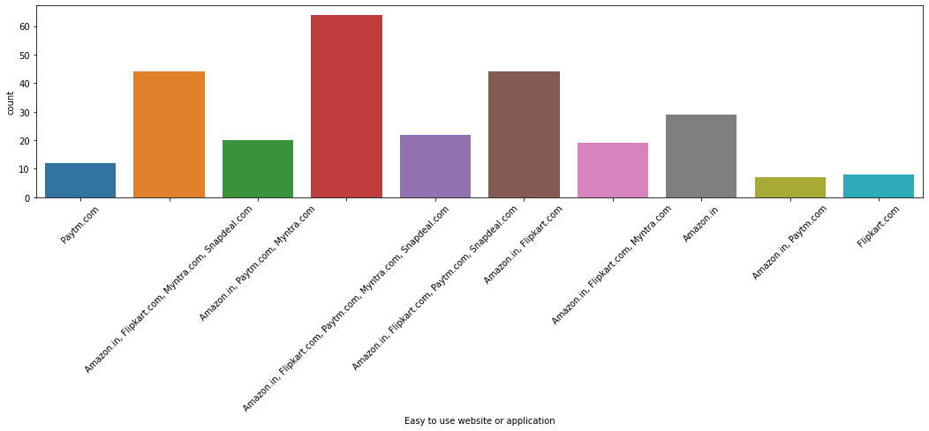
most of the participants feel Amazon.in, Flipkart.com, Paytm.com, Myntra.com, Snapdeal.com are easy to use

Slide 14
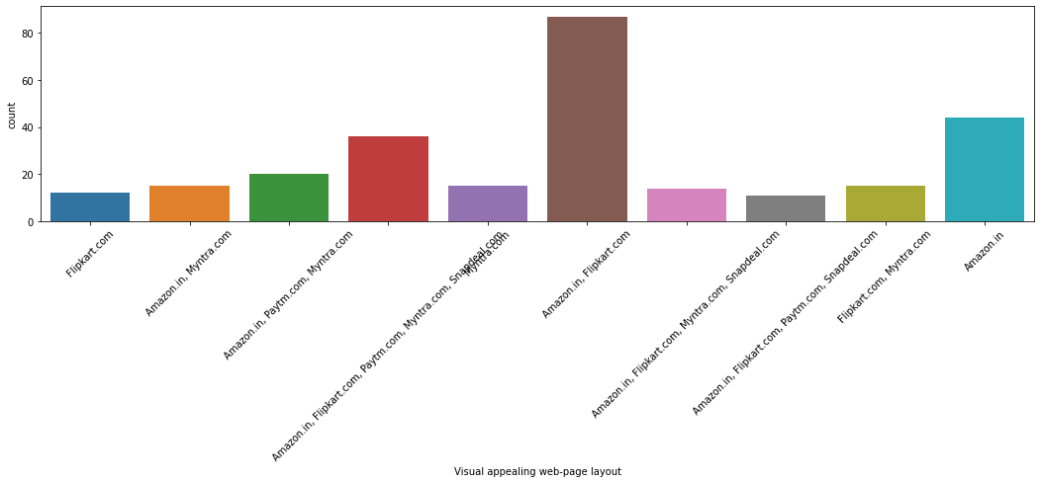
In terms of Visual appealing web-page layout Amazon.com and Flipkart.com seems to take the lead.

Slide 15
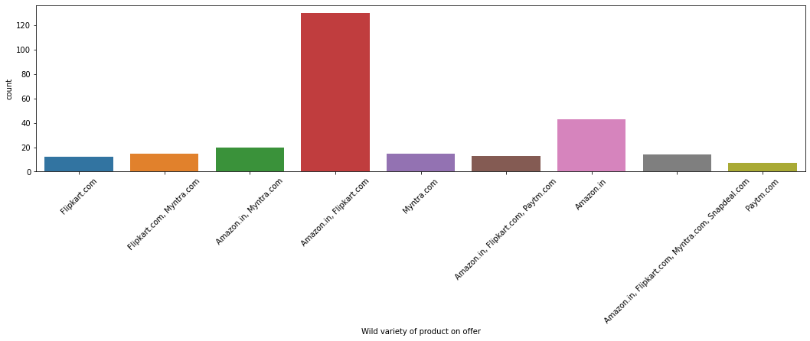
wild variety of products on offers are the highest in amazon.in and flipcart.com

Slide 16
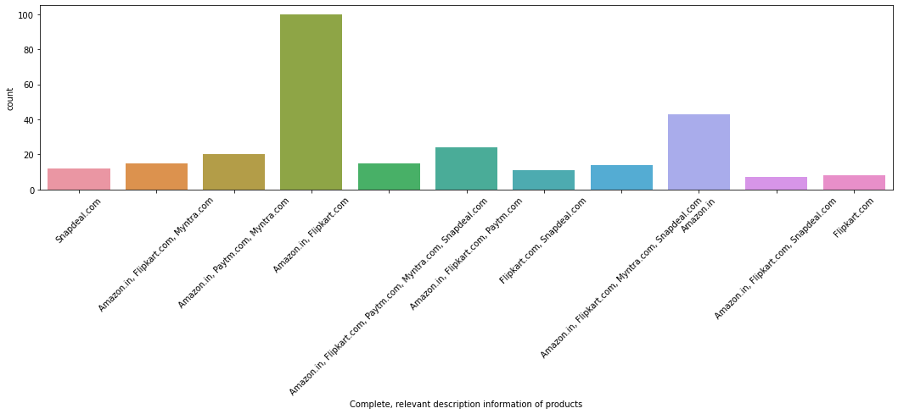
the complete and proper description of the product are the best in amazon.in and flipcart.com

Slide 17
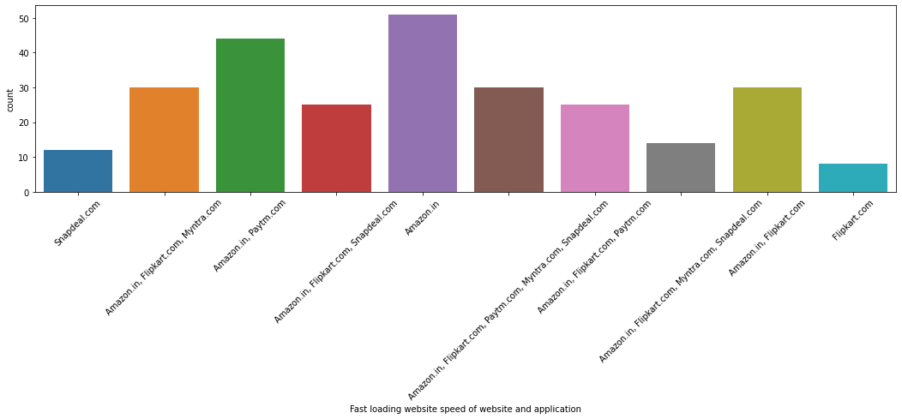
the speed of opening of loading the website is good in amazon.in compared to the other e-retail shops

Slide 18
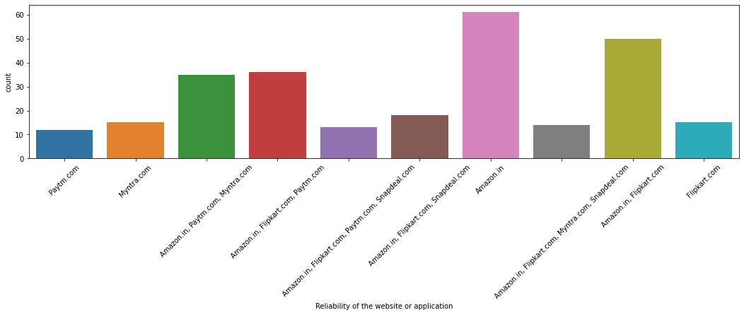
reliability of website/app is the best in Amazon.in

Slide 19
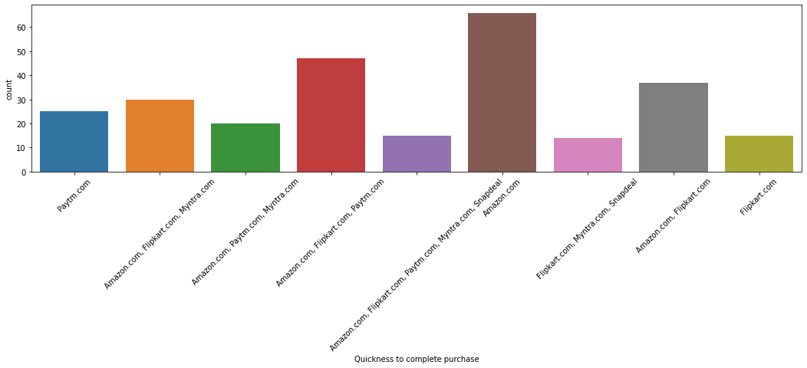
the fastest purchase of objects can be done in Amazon.in according the customers

Slide 20
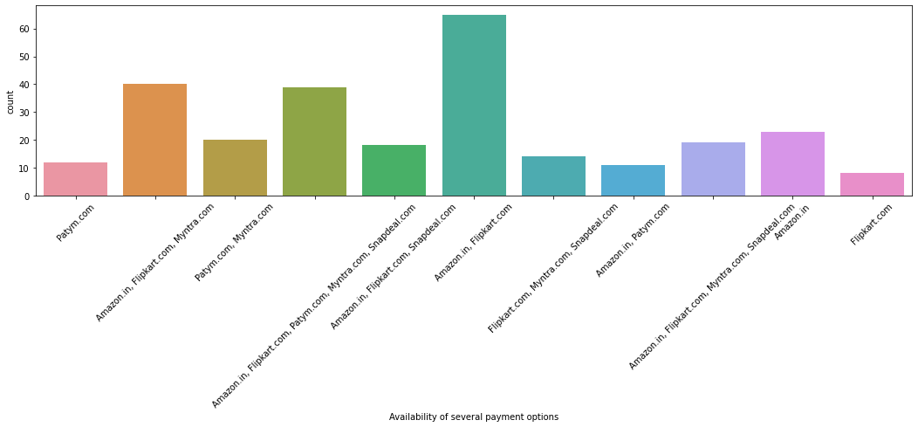
the availability of payment options are more in Amazon.in and Flipcart.com

Slide 21
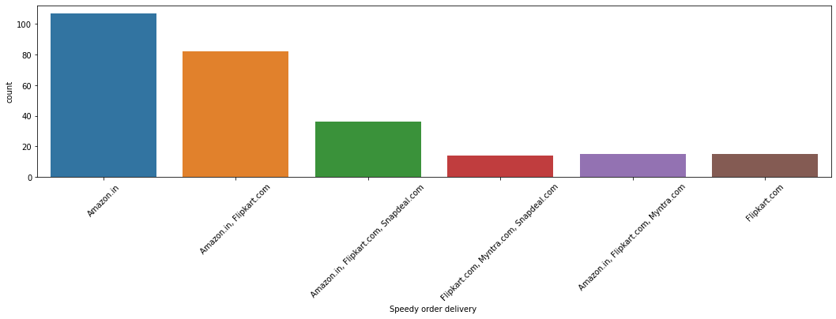
the fastest delivery can be done in Amazon.in according to the customers

Slide 22
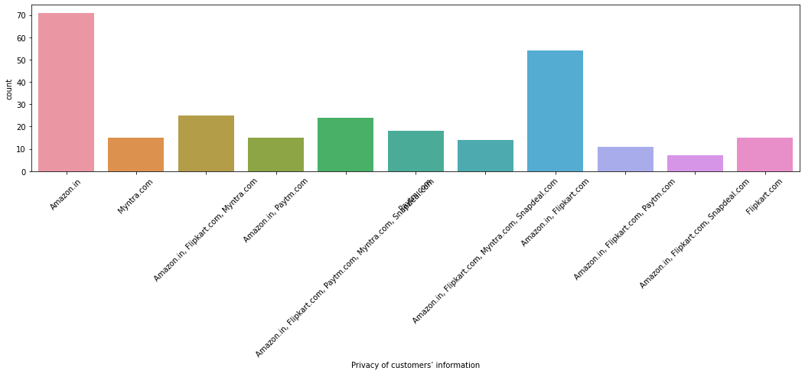
privacy of customers information in more secure in Amazon.in according to the customers

Slide 23
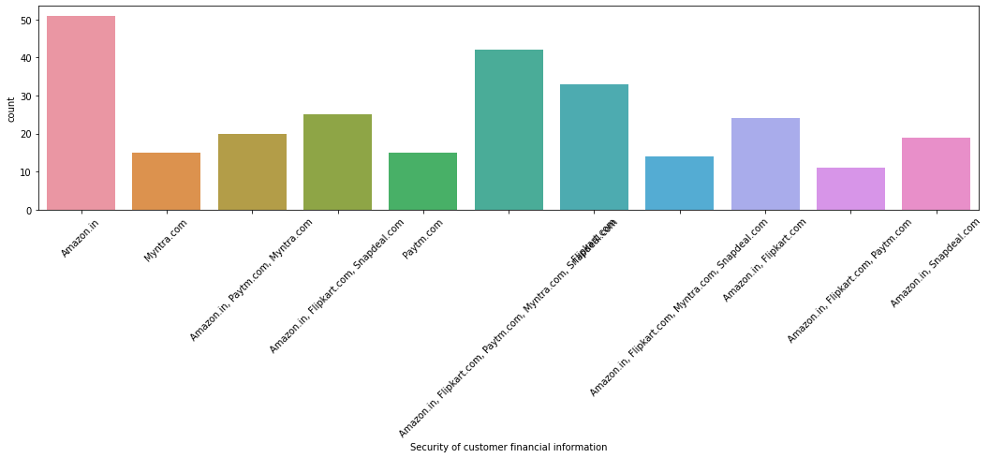
security of customers financial information is more secure in Amazon.in according to the customers

Slide 24
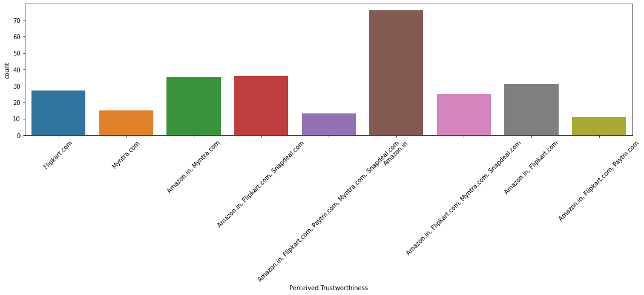
trust they built from customers is high/good in Amazon.in

Slide 25
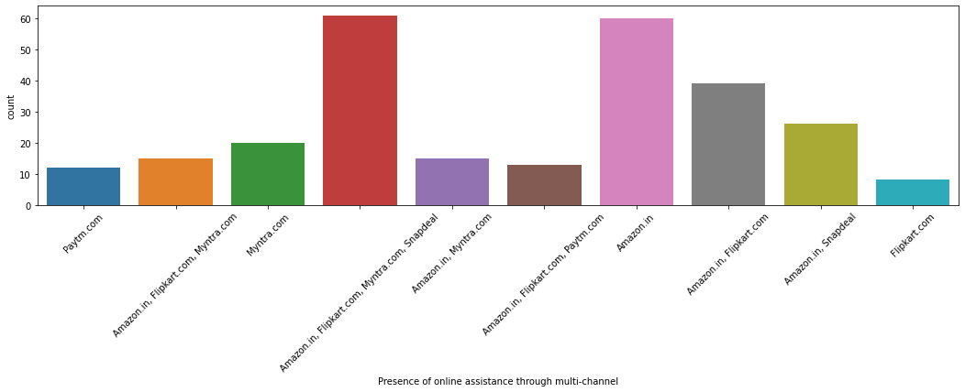
online assistance is good in Amazon.in, Flipcart.com, Myntra.com and snapdeal.com according to the customers

Slide 26
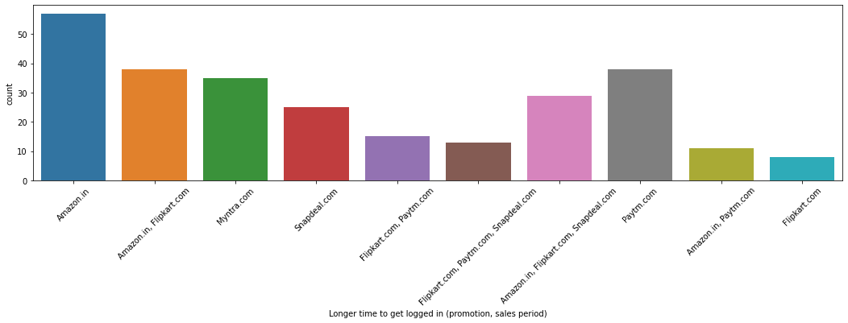
Amazon.in takes longer time to get logged in according to the customers

Slide 27
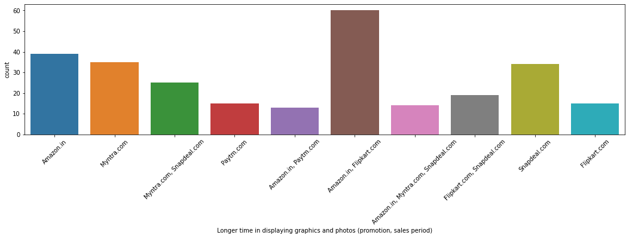
Amazon.in and Flipcart.com takes longer time for displaying graphics and photos according to the customers

Slide 28
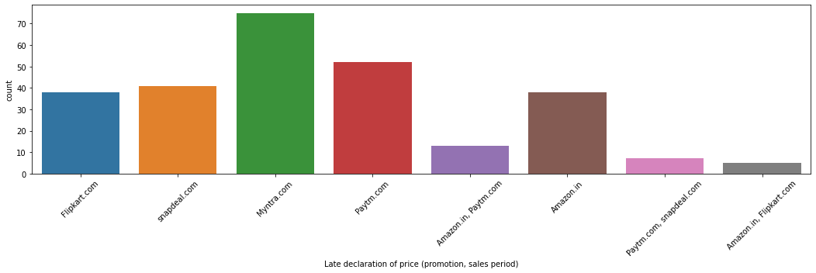
late declaration of price happens more in Myntra.com

Slide 29
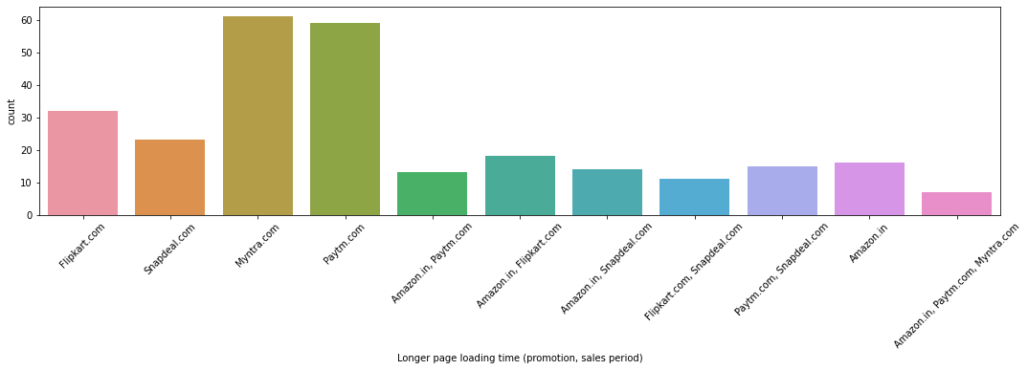
Myntra.com takes the time for loading the page

Slide 30
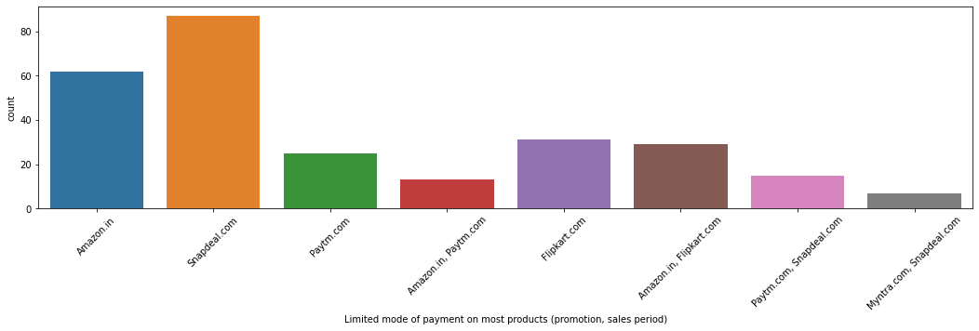
there is only limited payment mode in snapdeal.com

Slide 31
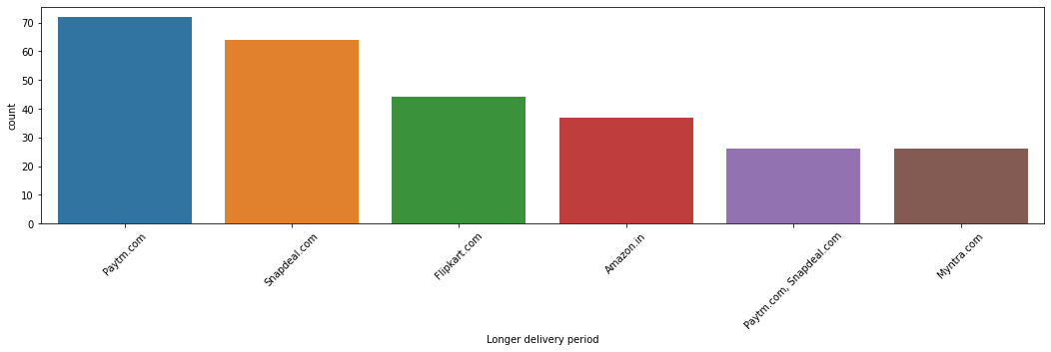
snapdeal.com takes longer time in delivering 27. Amazon.in updates its design more frequently

Slide 32
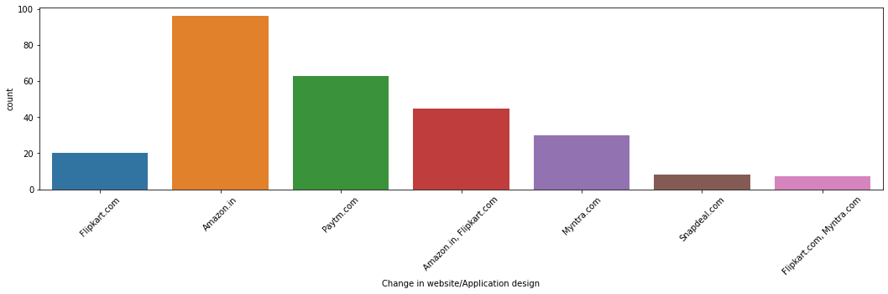
Amazon.in changes its website/application design frequently

Slide 33
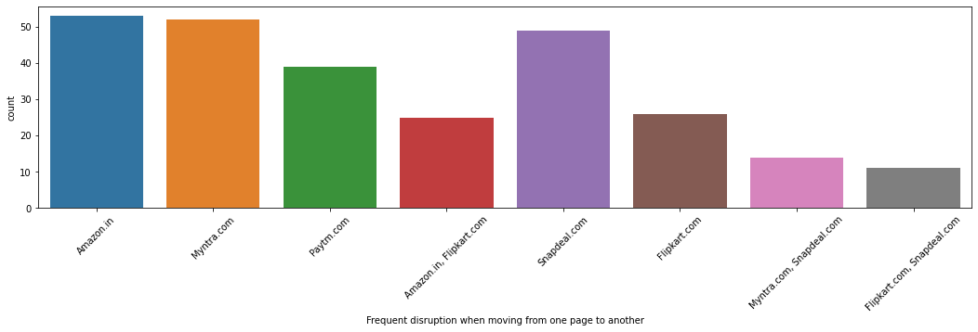
according to the customers frequent disruption while moving from one page to another happens more in Amazon.in

Slide 34
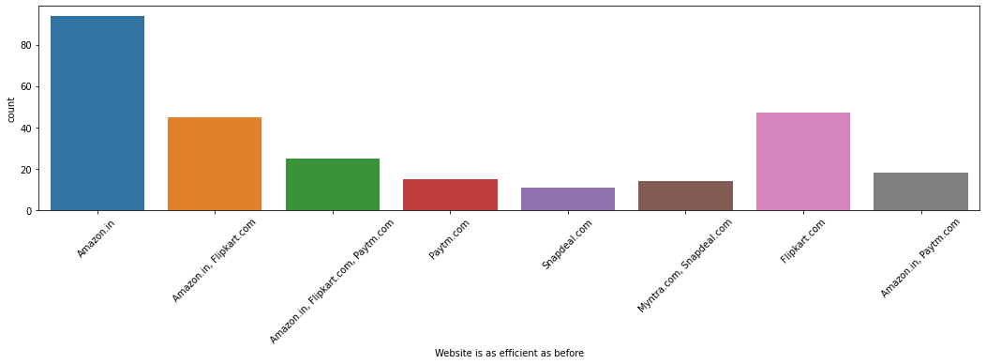
Website efficiency is good in Amazon.in

Slide 35
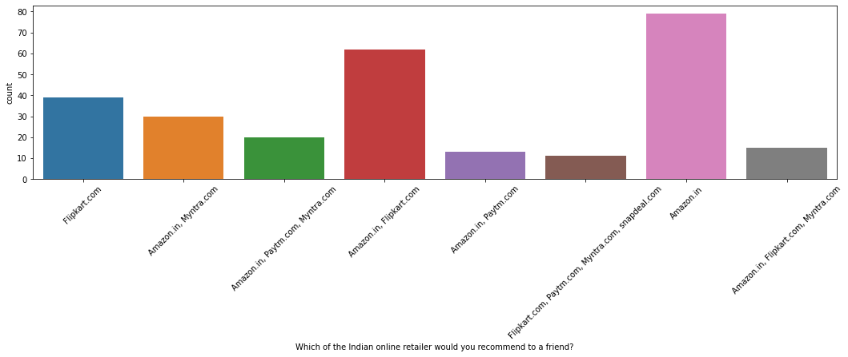
most of the customers would recommend Amazon.in as a online retail shop to a friend

Slide 36
Conclusion:
From all the analysis done we can say that Amazon.in is the best retail shop. The only negative point is, there is frequent disruption while moving one page to another

Slide 37
Thank you

